Slide 1
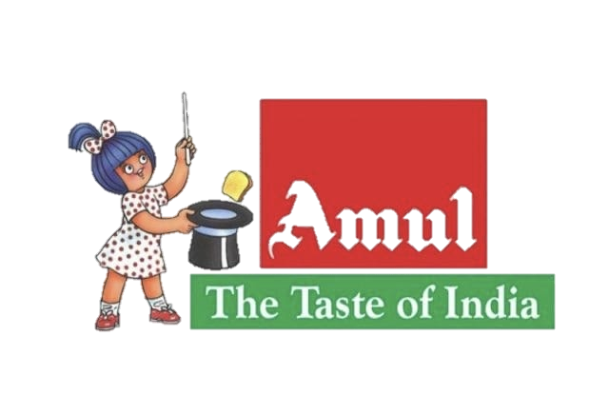
Amul – The Taste of India
Presented by
K. Sri Lakshmi Thantri

Slide 2
agenda
INTRODUCTION
BRAND STUDY, COMPETITOR ANALYSIS, AUDIENCE PERSONA
SEO & KEYSEARCH
CONTENT IDEAS & MARKETING STRATEGIES
CONTENT CREATION AND CURATION

Slide 3
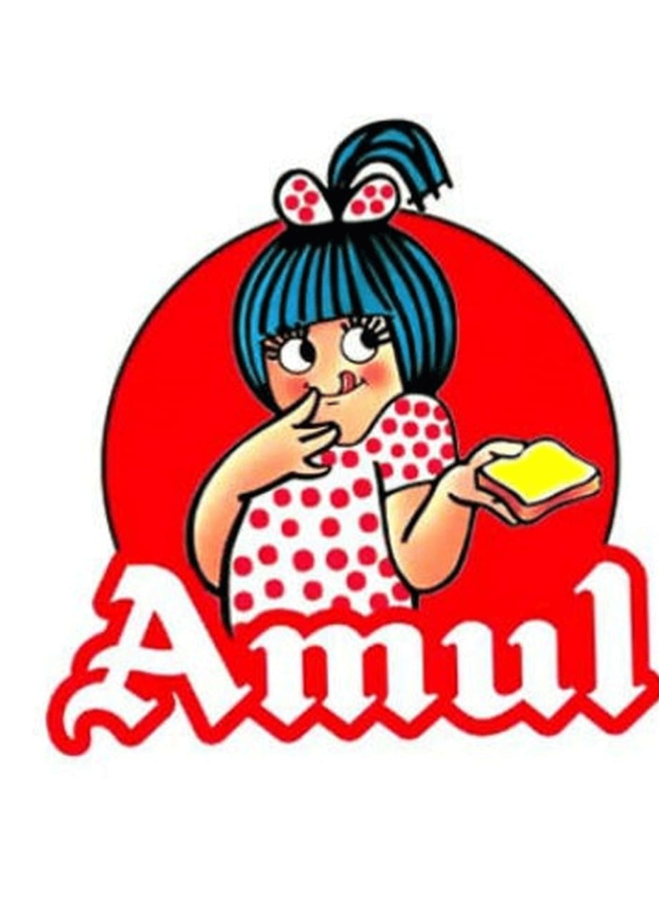
Introduction
Amul is an acronym (Anand Milk Union Ltd) of the Indian corporative society name Gujarat Milk Marketing Federation based in Anand, Gujarat. It is under the ownership of Gujarat Cooperative Milk Marketing Federation Ltd, Department of Cooperation, Govt. of Gujarat. Amul, the ‘utterly, butterly, delicious’ company, was started by
Dr. Verghese Kurien (Father of India’s White Revolution) in Anand, Gujarat as a cooperative to purchase the milk supplied by nearby farmers.

Slide 4
Brand study, Competitors analysis, Audience persona

Slide 5
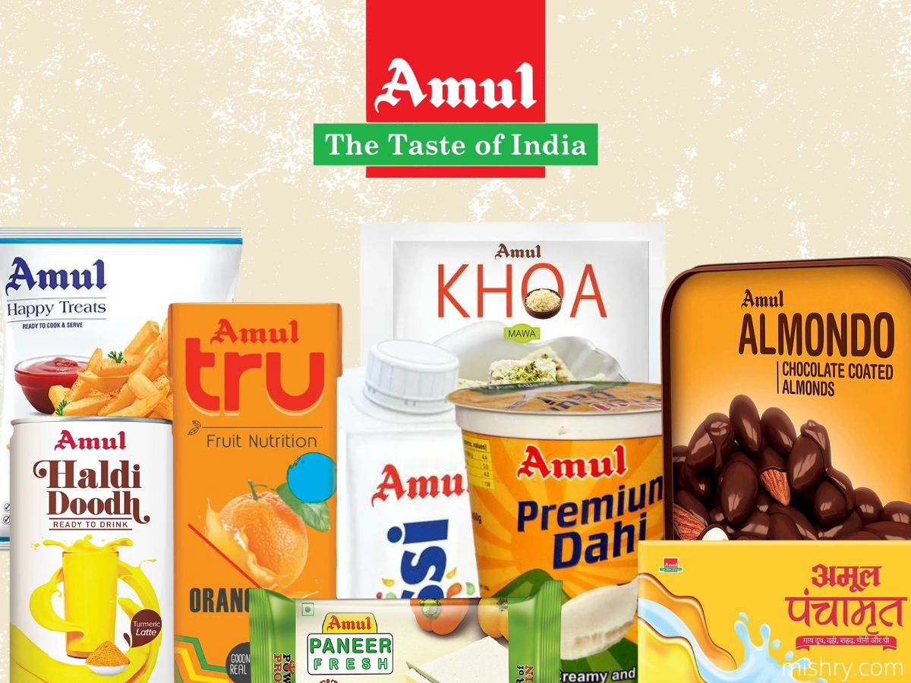
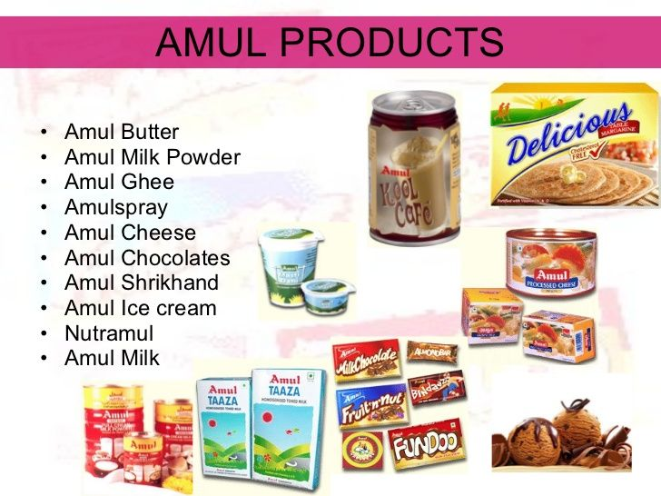
Research Brand:
There are many products related to the Amul brand. It provides many healthy and hygienic products. It provides the products in offline as well as online also.

Slide 6
Mission/Values
We the motivated and dedicated workforce at Amul are committed to produce wholesome and safe foods of excellent quality to remain market leader through development of quality management system, state of art technology, innovation and eco-friendly operations to achieve delightment of customers and milk producers.

Slide 7
Analyze Brand Tone and Identity
Amul’s brand identity is centered around the iconic “Amul Girl”, a young girl in a polka-dot dress who has become synonymous with the brand.

Slide 8
Audience Persona
Amul has a broader target audience, from the toddler to aged people. It caters to the widest range of products, like Amul Milk, buttermilk, lassi, butter, cheese, milk powder, etc.,. for every social group and member of society by keeping their best interest in mind to meet their needs at an affordable price. Currently ranked as the eighth largest dairy organization in the world.

Slide 9
Competitor Analysis
The top competitors of Amul include Akshayakalpa, Godrej Agrovet, Milky Mist, Britannia Industries, Mother Dairy, Nestle, Kwality Wall’s, Baskin-Robbins, Dodla Dairy and Milk Mantra. Amul has 273 active competitors.

Slide 10


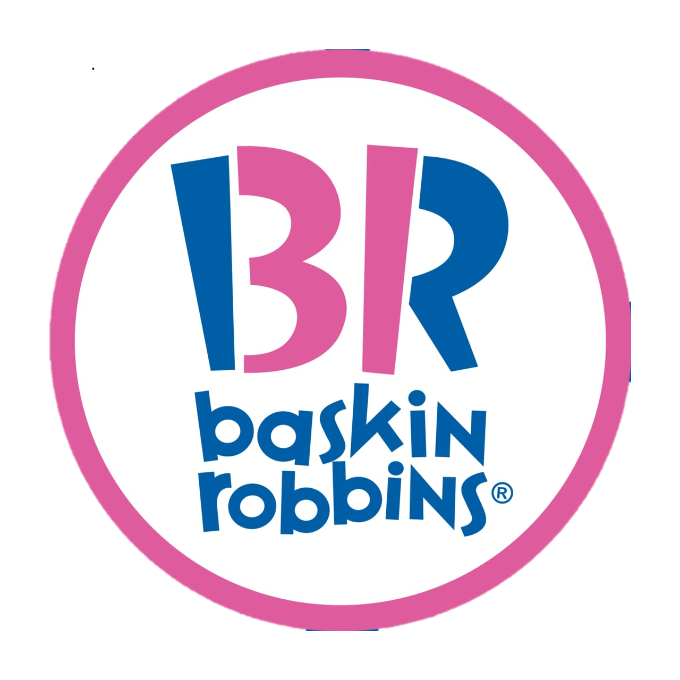
Competitors of Amul
Nestle
Britannia ranked third and Amul fourth among the top five strongest food brands in the world. The strength of brands is evaluated based on metrics such as marketing investment, stakeholder equity, and business performance.
Baskin Robbins
Amul, the country’s largest food brand, has widened its lead over nearest competitors Nestle, leaving the world’s largest food company a distant second despite having completed 100 years of business in India.
Britannia
A strong Amul competitor, Baskin Robbins was founded in the year 1945. It is the largest specialty sore chain and the company is headquartered in US. The company has popular for their 31 flavors which are significant in their logo.

Slide 11
SEO & KEYWORD RESEARCH

Slide 12
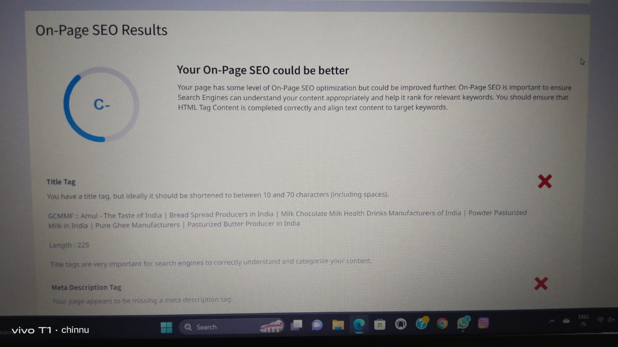
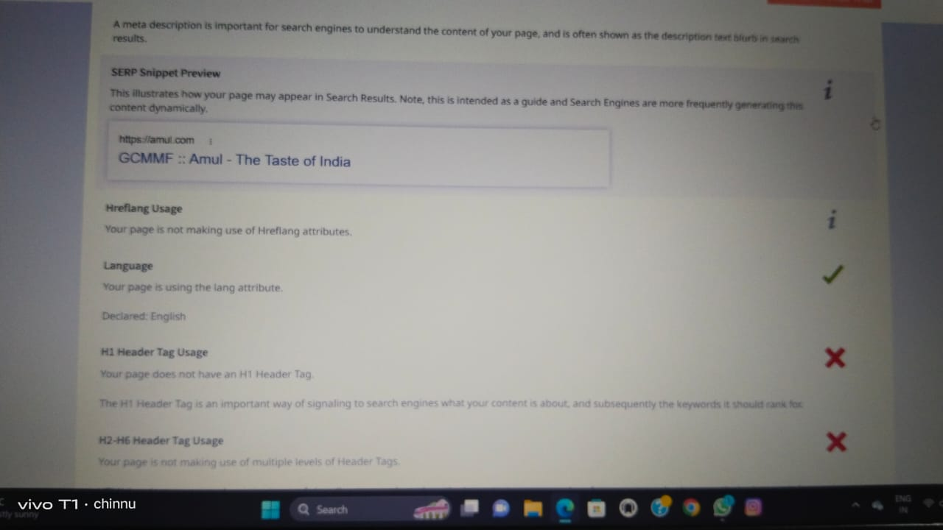
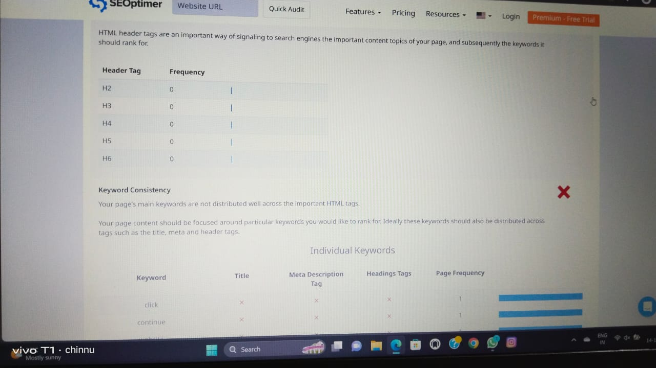
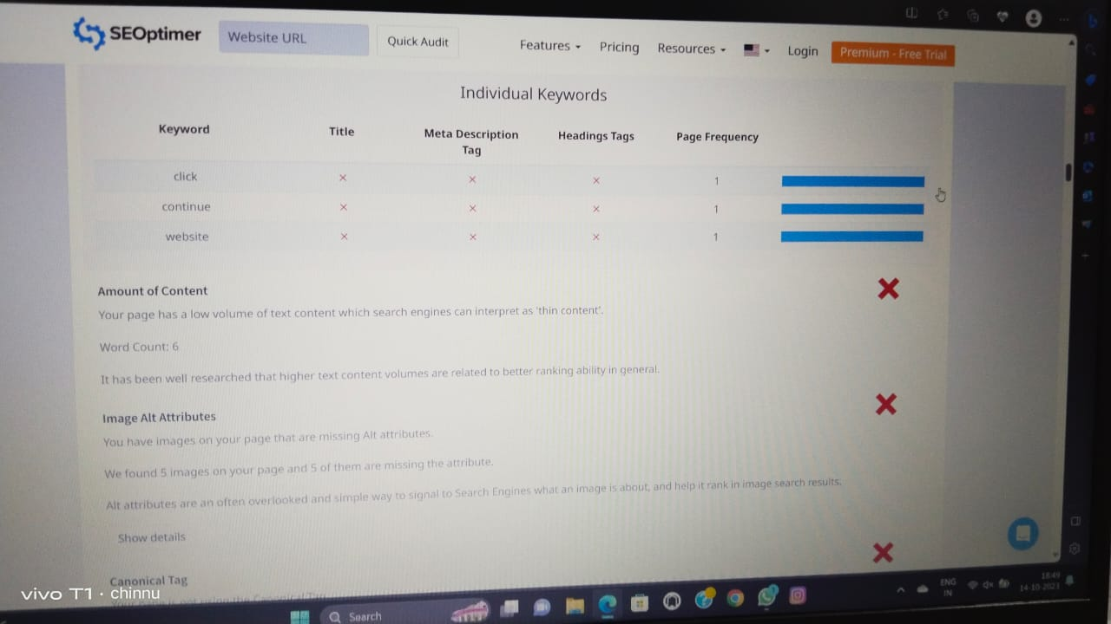
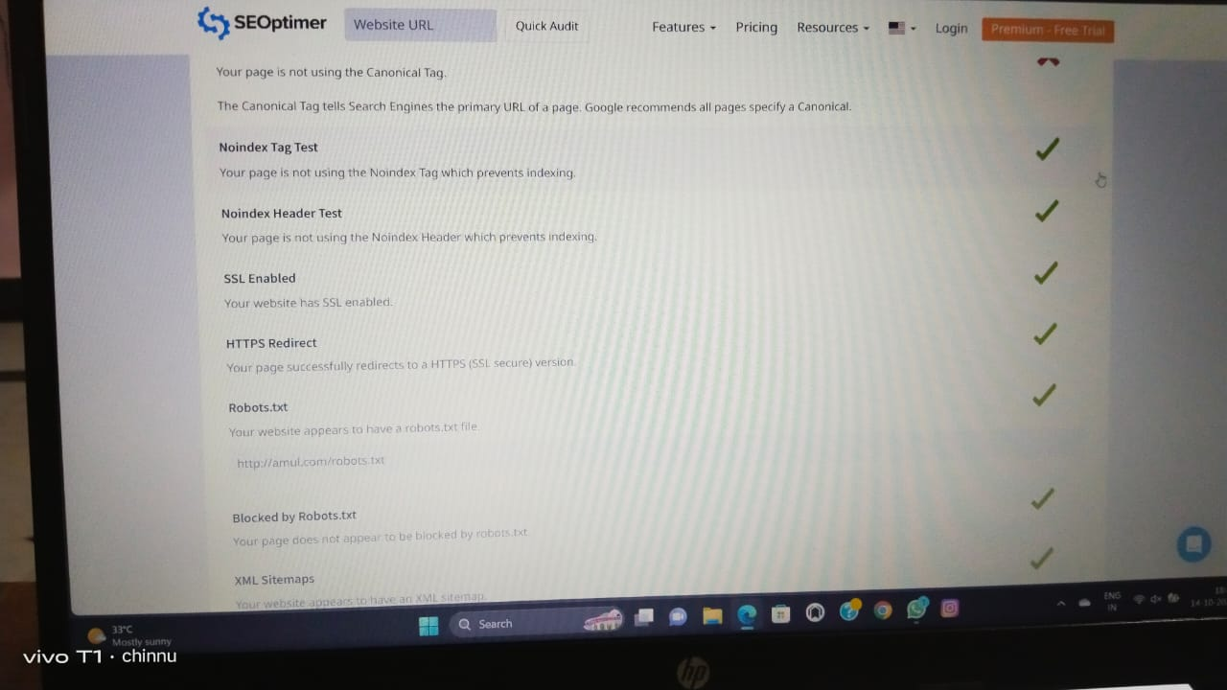
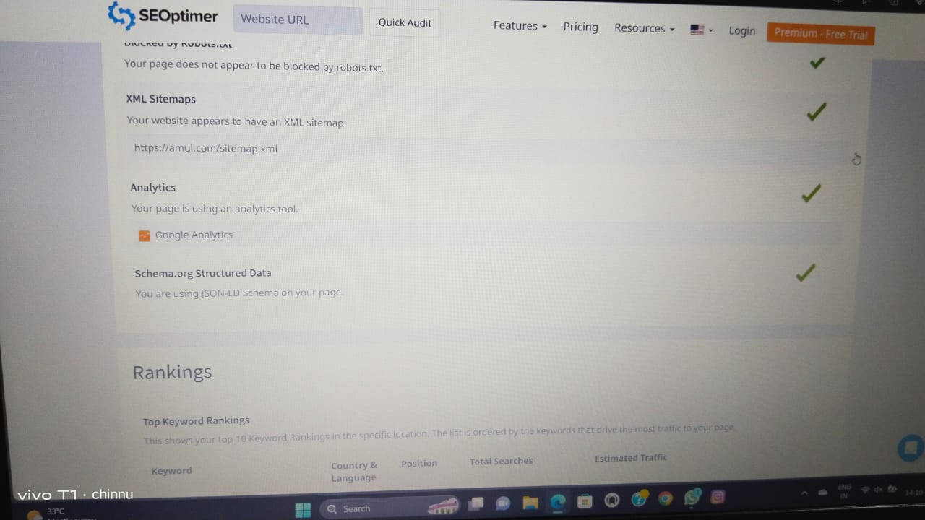
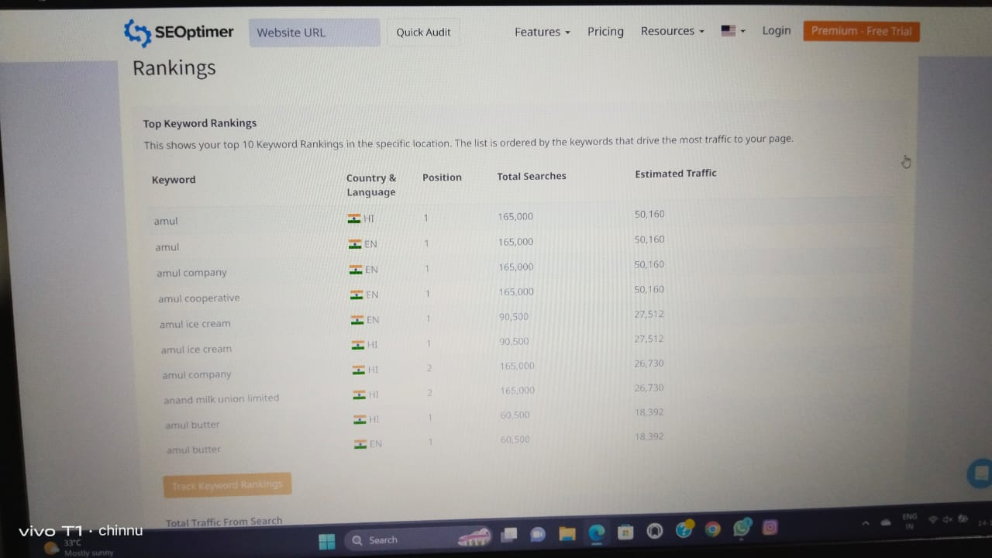
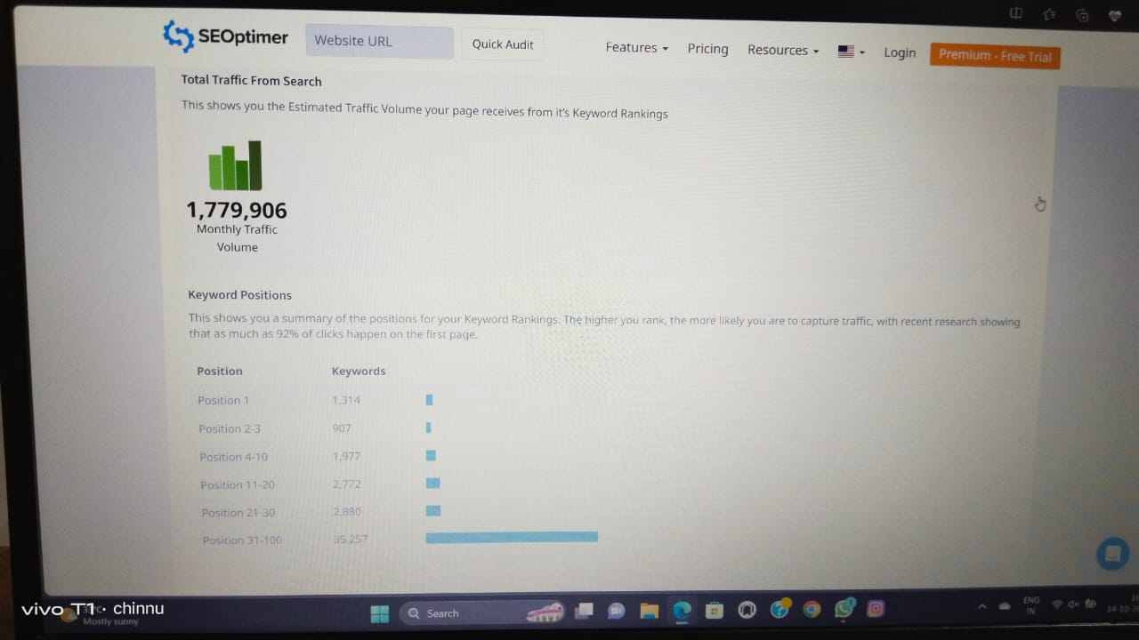
SEO Audit

Slide 13
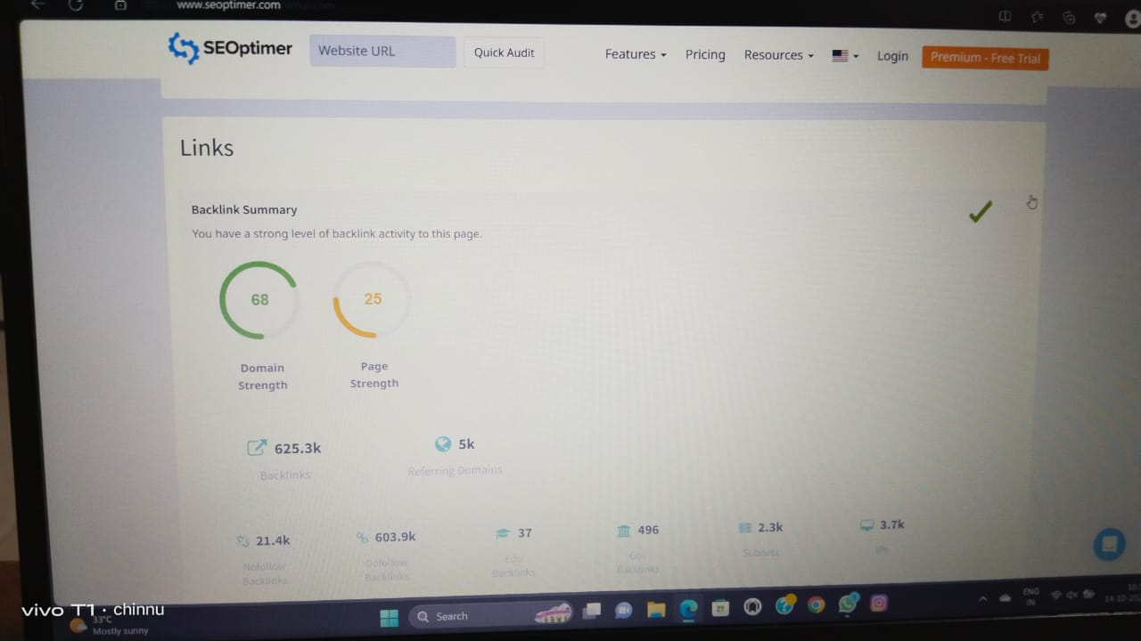
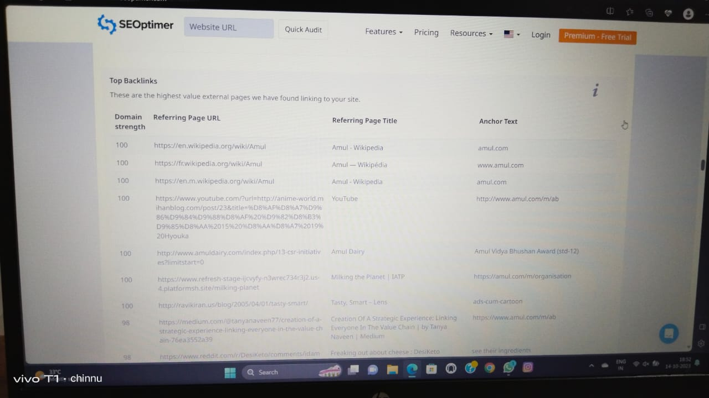
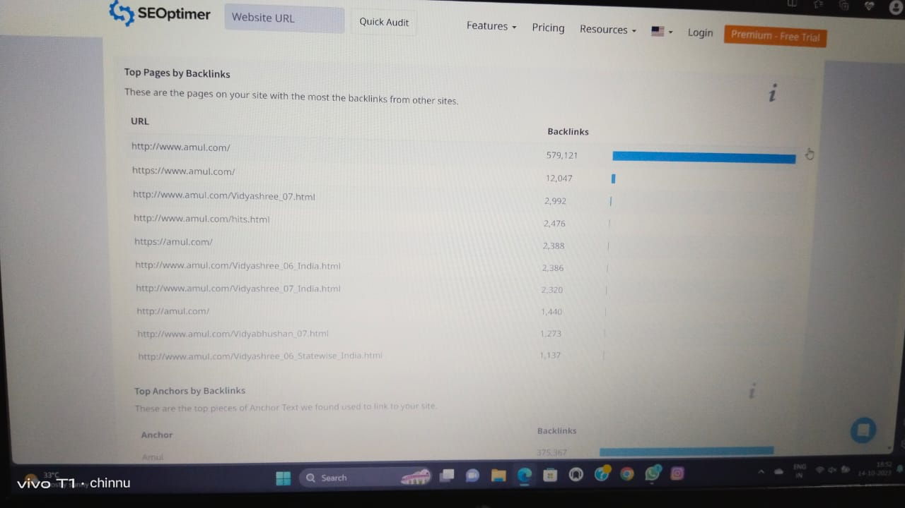
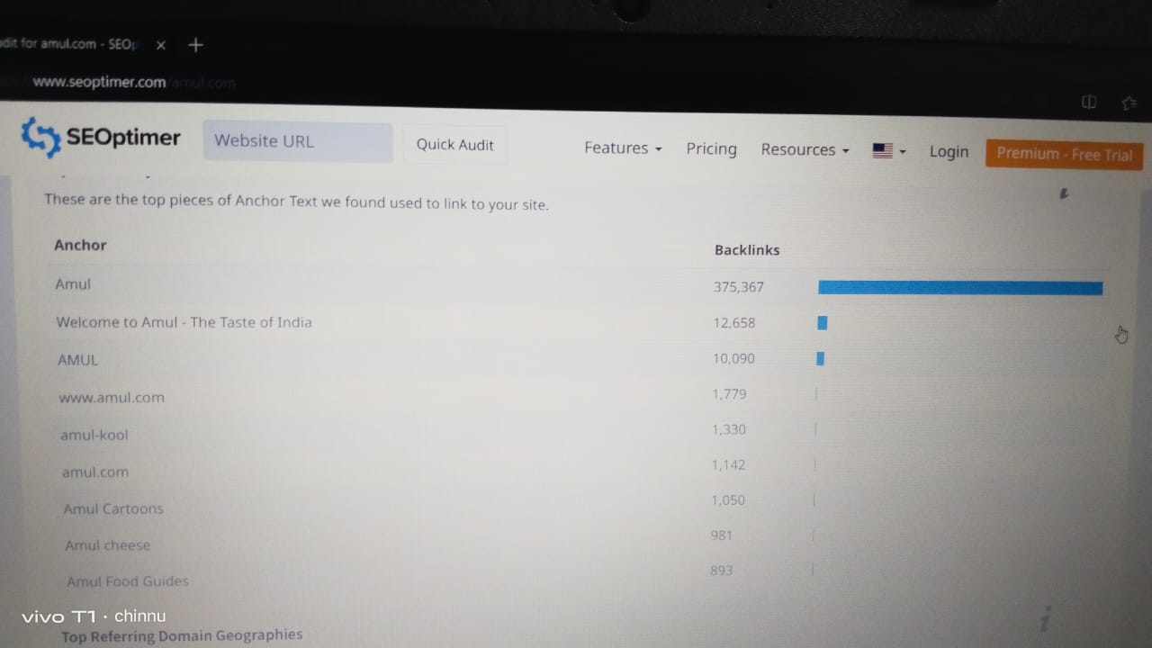
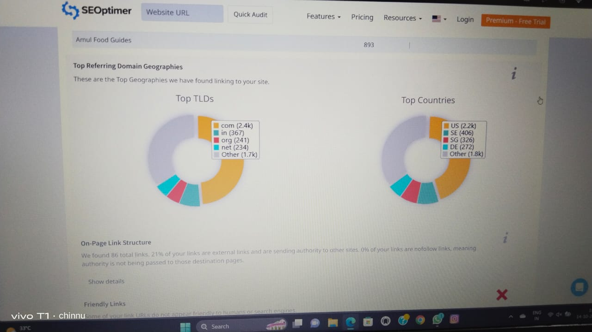
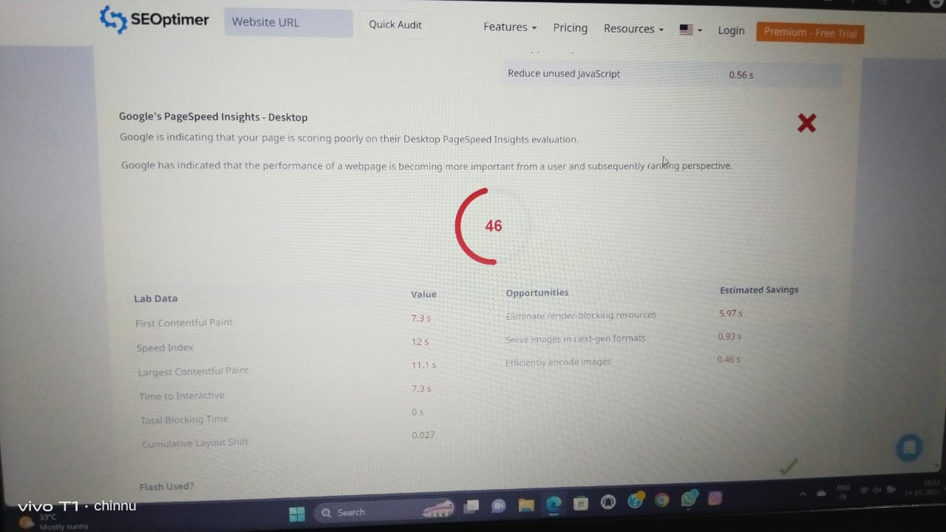
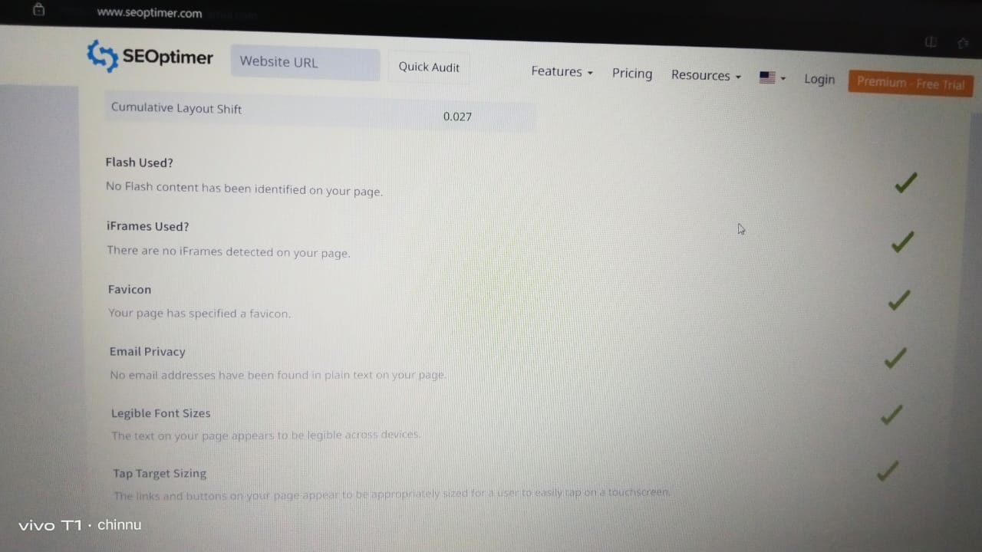

Slide 14

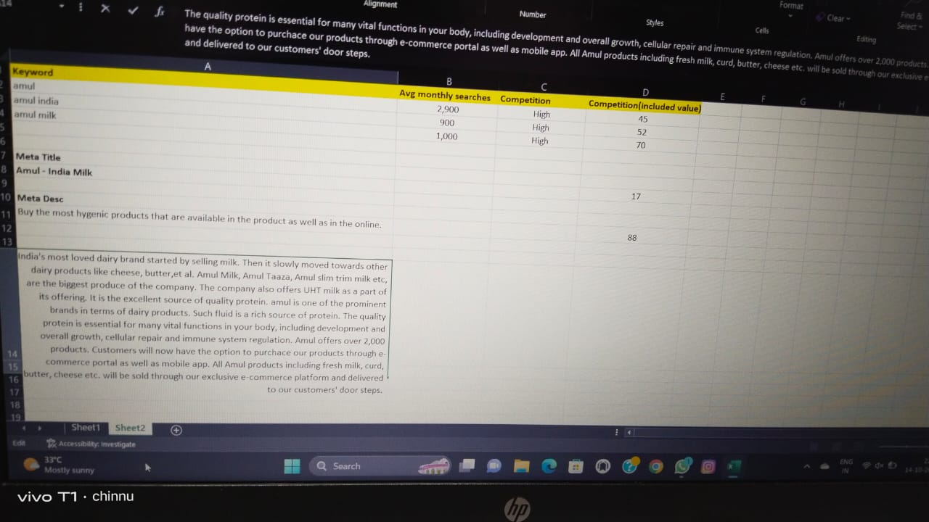
Keyword Research

Slide 15
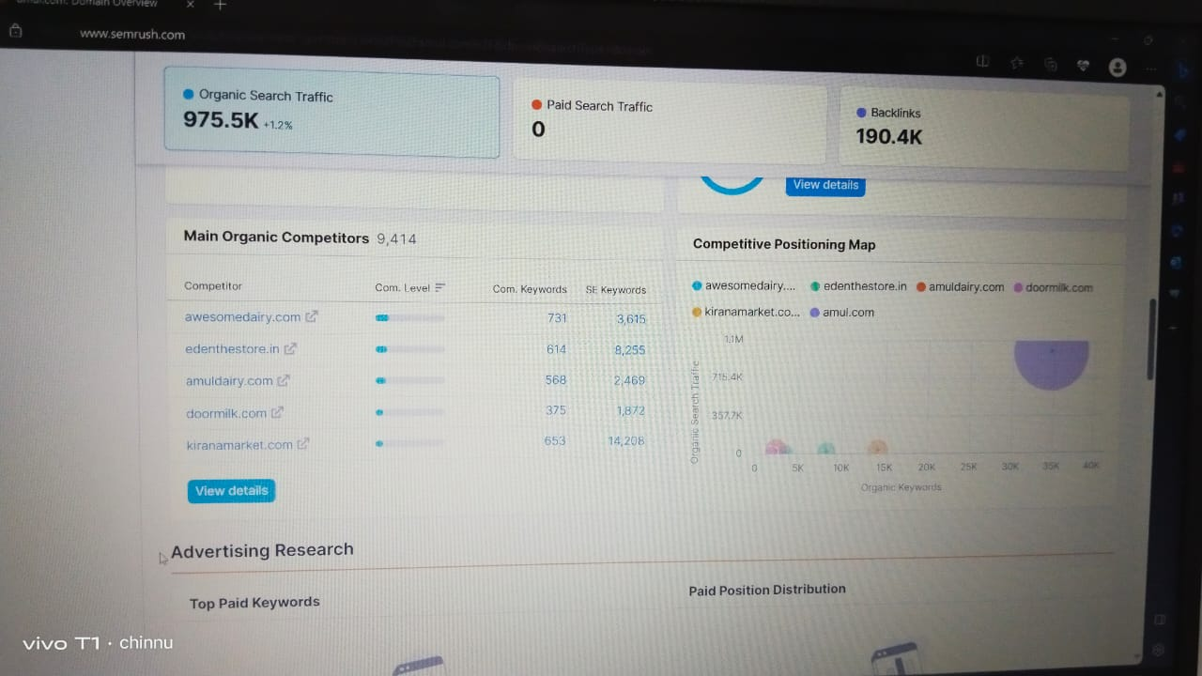
On Page Optimization

Slide 16
Content Ideas & Marketing Strategies

Slide 17
Content Ideas Generation & Strategy
Sunday | Monday | Tuesday | Wednesday | Thursday | Friday | Saturday
15 | 16 | 17 | 18 | 19 | 20 | 21
 | Curated content New blogs | Curated content | Curated content Podcasts | Blogs | Quizzes Assignment explanation
22 | 23 | 24 | 25 | 26 | 27 | 28
 |  |  | Curated content Videos | Videos | Quizzes Assignment explanation
29 | 30 | 31 |  | Key Happenings
 | Blogs Podcasts | Curated content | Curated content | New Blogs | Podcasts | Quizzes
 |  |  | Assignment explanation

Slide 18
Challenges
Amul faces stiff competition from both local and international dairy brands. The increasing number of players in the Indian dairy industry could impact Amul’s market share and growth prospects. Dairy products are perishable, which means they have a limited shelf life.

Slide 19
Marketing Strategies Process
Amul’s mascot
Its brand image as “The Taste of India”
Target audience segmentation
Low – cost products
Digital marketing efforts
Diverse product portfolio
Marketing mix

Slide 20
Content Creation & Curation

Slide 21
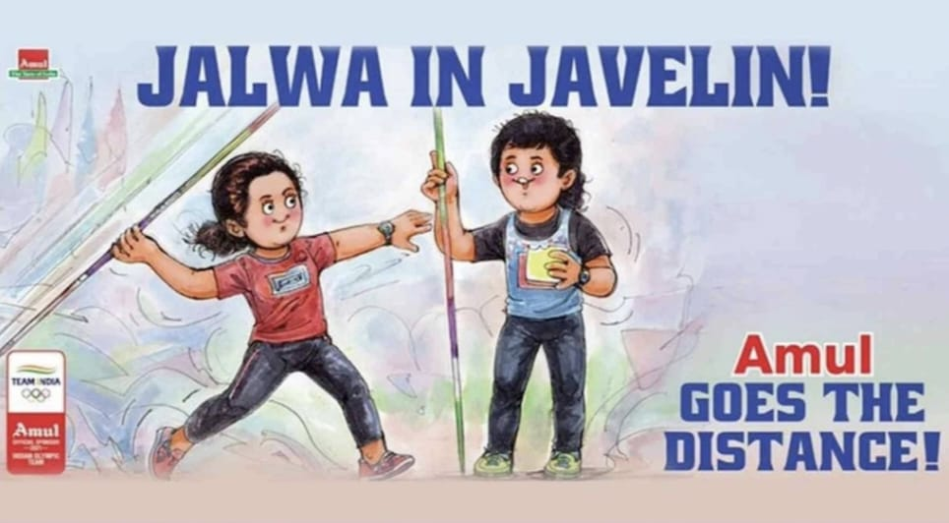
Select Content Categories
Format 1 : In Olympics 2021, when Neeraj Chopra won gold in the men’s javelin throw, the entire nation was proud. And Amul celebrated this pride with creative and cheeky ad about the Olympian. The ad showed the Amul girl throwing a javelin as Neeraj guided her. The tagline ‘jalwa in javelin’ was the apt for the situation.

Slide 22

Format 2 : It was quite of relief when the government opened vaccination slots for 18+ citizens. Amul motivated people to get vaccinated through a creative moment – based marketing ad. The tagline ‘your shot at butter’ was on point and loved by the audience.

Slide 23

Format 3 : Continuously increasing fuel prices is India’s aching nerve. Amul knows just how to soothe it with its funny ads. The company rolled out an ad showing Amul girl sulking over the fuel price. The tagline read ‘Painfuel increase, affordable taste’, subtly advertising Amul products.

Slide 24
Instagram Story
Instagram id – amu.l_products
Instagram id link - https://www.instagram.com/amu.l_products/?hl=en
Instagram story link:1 - https://instagram.com/stories/amu.l_products/3214736294725047245?igshid=MTc4MmM1YmI2Ng==
Instagram story link:2 - https://instagram.com/stories/amu.l_products/3214738349606950878?igshid=MTc4MmM1YmI2Ng==
Instagram story link:3 - https://instagram.com/stories/amu.l_products/3214742150040738483?igshid=MTc4MmM1YmI2Ng==
Instagram highlights link:1 - https://www.instagram.com/s/aGlnaGxpZ2h0OjE4MDk1MjUwNDMwMzcwMTgw?igshid=MzRlODBiNWFlZA==
Instagram highlights link:2 - https://www.instagram.com/s/aGlnaGxpZ2h0OjE4MjUxNDMzOTY3MjA3MzY2?igshid=MzRlODBiNWFlZA==

Slide 25

Instagram id

Slide 26

Designs/Video Editing
​

Slide 27

summary
It is the Apex organization of the Dairy Cooperatives of Gujarat, popularly known as ‘AMUL’, which aims to provide remunerative returns to the farmers and also serve the interest of consumers by providing quality products which are good value for money. Amul’s success can be attributed to its cooperative structure, focus on product quality and innovation, effective marketing and distribution strategies, and strong leadership. Over the years, Amul has become a household name in India and has earned the trust and loyalty of consumers.

Slide 28
Thank You
K. Sri Lakshmi Thantri

